Slide 1
DEPARTMENT OF ELECTRICAL AND ELECTRONICS ENGINEERING
18EEP202L-MINOR PROJECT – II
FINAL REVIEW
Smoke detector
YEAR/ SEMESTER – II/III
BATCH: NUMBER :05
DATE : 17/05/2024
GUIDED BY:
SUBRAMANIAM.G AP/EEE
PRESENTED BY:
MOHARAJAMOORTHY.K[927622BEE070]
SARAVANAKARTHICK.B[927622BEE102]
SOWMIYA.P.G[927622BEE111]

Slide 2
LIST OF CONTENTS
Problem Statement
Objective
Abstract
Description
Block Diagram
Cost Estimation
Survey Form Analysis
Implementation

Slide 3
PROBLEM STATEMENT
a) Steam interference :False alarm also will trigger when steam (maybe from bathroom or steam room)interrupt the light beams of electrical current inside smoke detector.
b) Dusty deception: High dusty area or insects can trip sensor inside alarm and make false alarm.
c) Residual smoke: Smoke from burned food (stoves, toasters or oven) also can trigger wrong alarm.
d) Delay trigger alarm: Available smoke sometime will take long delay although already detect smoke before trigger alarm to people.

Slide 4
OBJECTIVE
1) Detect Fire :Your fire alarm system is designed to detect fire in two main ways: smoke and heat. It should also have the capability of manual pull, in case a fire is observed before smoke or heat reaches the sensors of the system.
2) Alert Occupants : When the fire alarm system detects smoke, heat, or water movement, it alerts occupants of the building using both audible and visible alarms. These alarms will be bright, loud, obnoxious, and impossible to ignore, which help mobilize individuals to follow your evacuation plan. Using both types of alarms ensure that every person in the building is alerted

Slide 5
ABSTRACT
Most of the fire detection are performed by sensor-based systems which have perceived the temperature and smoke by themselves and utilized in various type of industry after combining with the fuzzy theory.
Generally this kind of methodology is useful for many spots of fire occurrences.

Slide 6
DESCRIPTION
Our project is based on the detection of smoke.
By using the IR sensor we will detect the smoke and with the help of alarm we can identify the smoke in the industries.
If there is any presence of smoke in the industries the sensor will find the and start to make an alert.
After the alarm sound we can identify the smoke proned areas and safegaurd ourselves.
With the help of this system we can safegaurd the labours working in the industries.

Slide 7
FLAME SENSOR
A flame detector is a type of sensor that can detect and respond to the presence of a flame . These detectors have the ability to identify smokeless liquid and smoke that can create open fire . For example, flame detectors are widely used ,as a flame detector can detect heat, smoke, and fire.

Slide 8

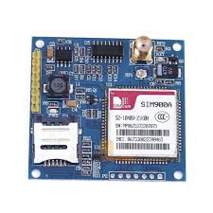


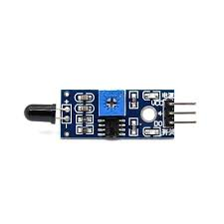
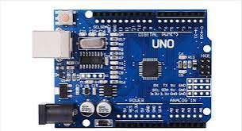
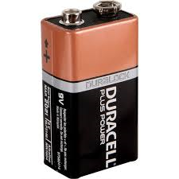
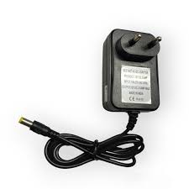
BLOCK DIAGRAM
Buzzer
Flame Sensor
Arduino Uno
GSM Module
Mobile
Fire
Battery
Charger

Slide 9
COST ESTIMATION
S.NO | COMPONENT DESCRIPTION | QUANTITY | COST
1 | ARDUINO UNO | 1 | 1,100
2 | FLAME SENSOR | 1 | 250
3 | BUZZER | 1 | 50
4 | JUMPER CABLES | 1 | 200
5 | LED LIGHT | 1 | 100
6 | GSM MODULE | 1 | 500

Slide 10
SURVEY FORM ANALYSIS
Name and address of the community:
Mr. V. Mohan , Madhiyampatty , Namakkal .
Mr. Somasundharam , Akkaraipatti , Namakkal.
Mr. Murugan , Cotton mill, Vempathy road, Thavittupalayam, Anthiyur.

Slide 11




Slide 12
IMPLEMENTATION
We successfully implemented our project at home , to address the pre-existing issue.
The execution of the project was flawless , resulting in the successful resolution of the problem.
The project achieved its objectives with precision and efficiency.

Slide 13
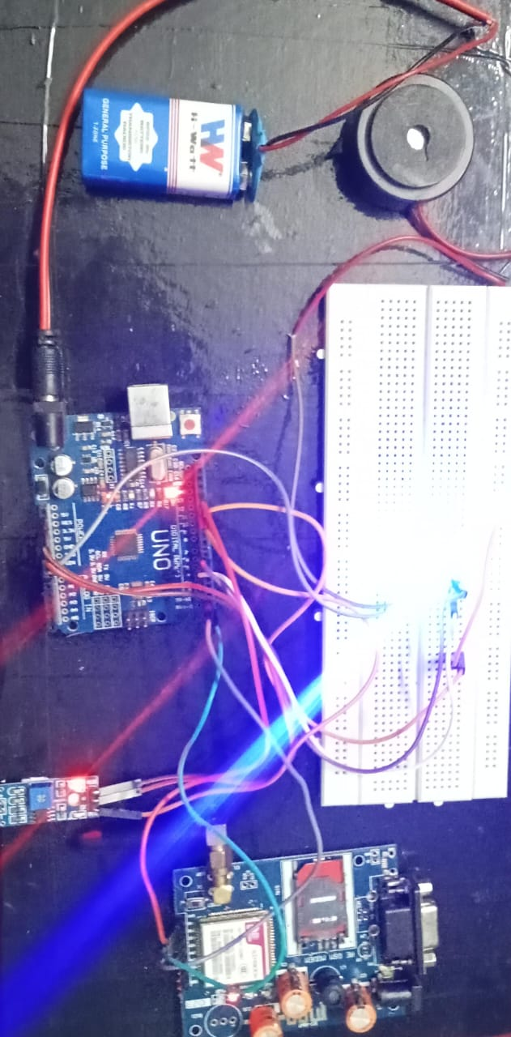

IMPLEMENTATION

